Slide 1
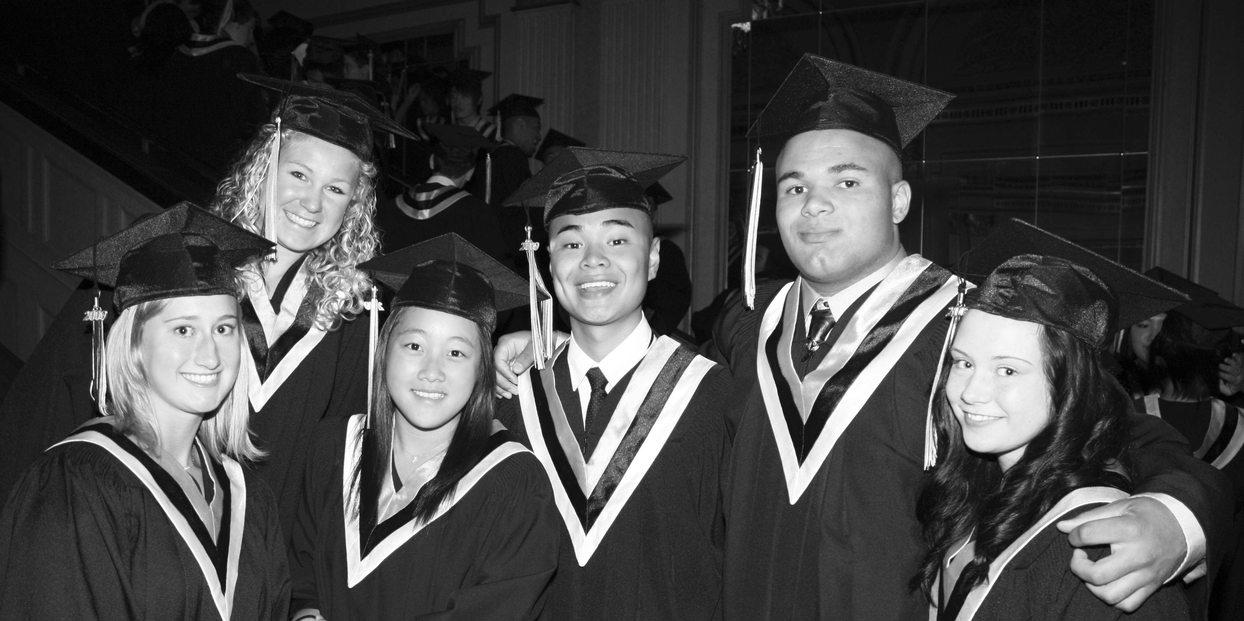
Planning for Graduation
OUTLINE:
Graduation Requirements
Provincial Exams
Mandatory Courses
Elective Courses
Language Requirements
Grad Transitions
Work Experience
Apprenticeship Programs

Slide 2
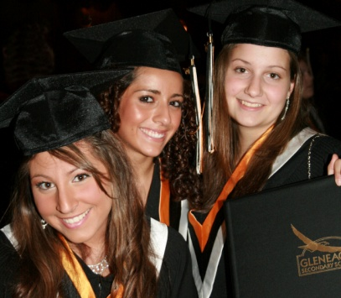
Graduation Requirements
Graduation
Requirements
Required Courses = 52 Credits
English 10,11 & 12 12 credits
Math 10 & 11 8 credits
Science 10 & 11 8 credits
Socials 10 & 11 8 credits
Physical Education 10 4 credits
FA or AS 10, 11, & 12 4 credits
Planning 10 4 credits
Graduation Transitions 4 credits
Elective Courses 10, 11 & 12 = 28 credits
80 credits

Slide 3
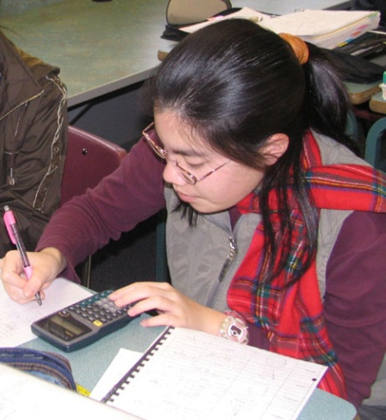
Provincial Exams
Graduation Requirements
Complete Five Provincial Exams:
Grade 10 English 10 Science 10 Math 10 Grade 11 Social Studies 11 Grade 12 English 12 (or Com 12)
MUST HAVE

Slide 4
Choices in English
English
Options
English 10 or English 10 Honours
English 11 or Communications 11
English 12 or Communications 12
MUST HAVE

Slide 5
Graduation Requirements
Graduation
Requirements
Students need 4 courses at the grade 12 level:
English 12 or Communications 12
+
3 grade 12 level courses
MUST HAVE
Examples:
Eng 12 + Economics 12 + PE 12 + Accounting 12
Eng 12 + Math 12 + Geography 12 + History 12
Com 12 + Auto 12 + Fitness 12 + French 12

Slide 6
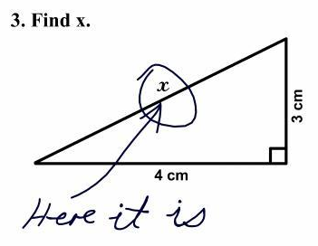
Math
Options
10
Grade 10 Math Options:
Foundations & Pre-Calculus 10 (academic)
Foundations & Pre-Cal 10 Honours (accelerated)
Apprenticeship & Workplace Math 10 (practical)
MUST HAVE

Slide 7
Math
Options
11
Grade 11 Math Options:
Pre-Calculus 11 (academic math)
Foundations of Math 11 (academic math)
Apprenticeship & Workplace Math 11(practical math)
10
MUST HAVE

Slide 8
Math
Options
12
Grade 12 Math Options
Pre-Calculus 12
Calculus 12
AP Calculus AB
Math requirements for post secondary admission:
*check post-secondary websites for specific requirements

Slide 9
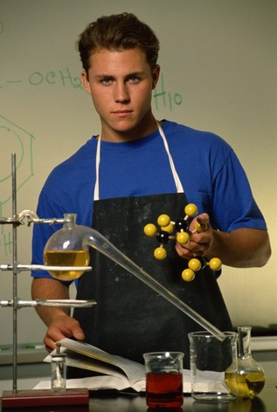
Science
Options
Must have Science 10 and a
Grade 10
Science 10 / Science 10 Honours
Grade 11 (only need one of these)
Chemistry 11 Earth Science 11
Physics 11 Biology 11
Science & Technology 11
MUST HAVE

Slide 10
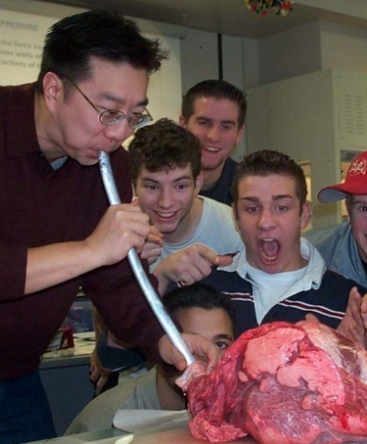
Science
Options
Grade 12 Options:
Biology 12
Chemistry 12
Physics 12
Geology 12
Geography 12
Check specific Science requirements for post secondary admission directly with the institution!

Slide 11
Social Science
Options
Electives in Science:
Philosophy 12
AP Psychology 12
These courses do not always meet university requirements for admission

Slide 12
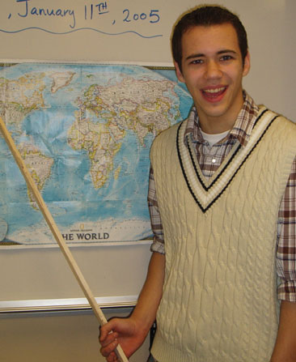
Social Studies
Options
Grade 10
Socials 10 / Socials 10 Honours
Grade 11
Socials 11
MUST HAVE

Slide 13
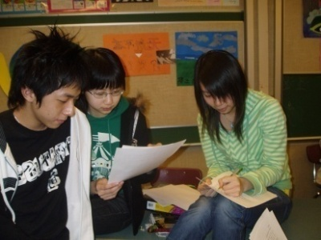
Social Studies
Options
Comparative Civilizations 12
Geography 12
History 12
Law 12
Economics 12
AP Economics 12
AP European History

Slide 14
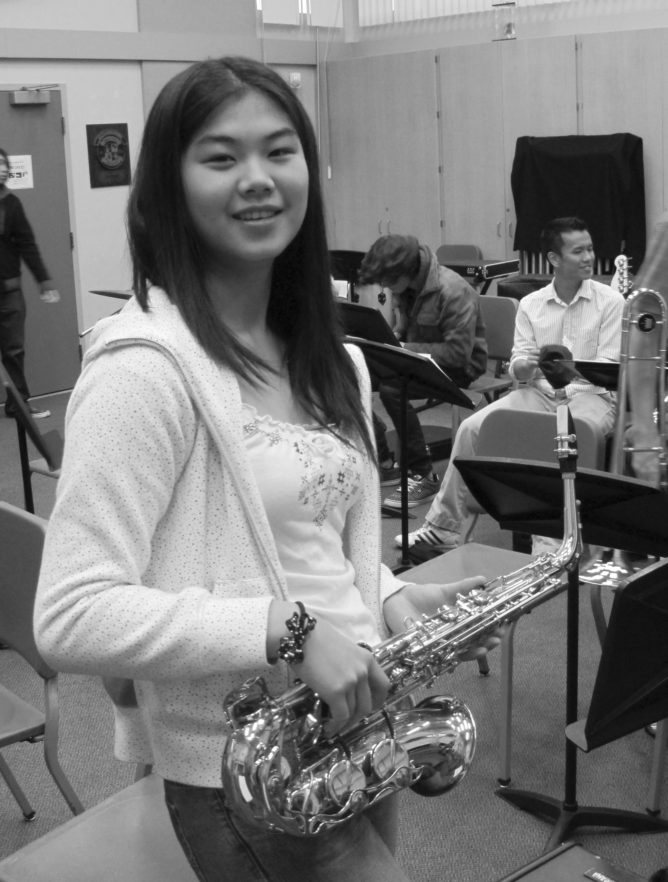
Fine Arts and/or Applied Skills
Graduation
Requirements
Complete (at least one) Fine Arts (FA) or Applied Skills (AS) course in either grade 10, 11 or 12.
Examples:
Art 11, Accounting 11, Cook Training 11, Foods & Nutrition 11, Animation 11, Band 10, Economics 12, Auto Technology 11, Drama 10
MUST HAVE

Slide 15
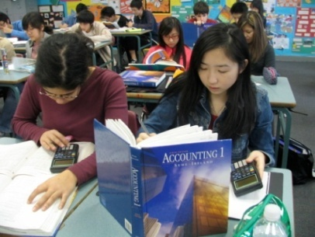
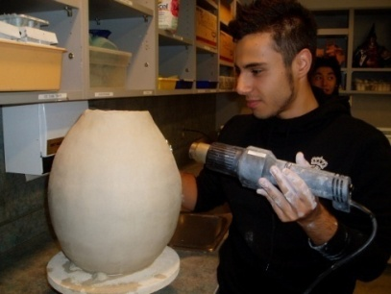
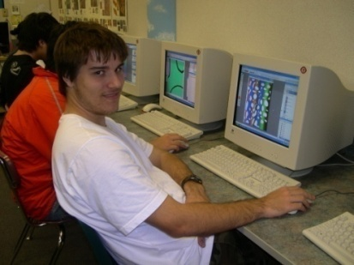
Elective
Choices
Grade 10s choose 2 electives
Grade 11s choose 4 electives
Grade 12s choose 7 electives
Everyone must choose 2 alternate electives

Slide 16
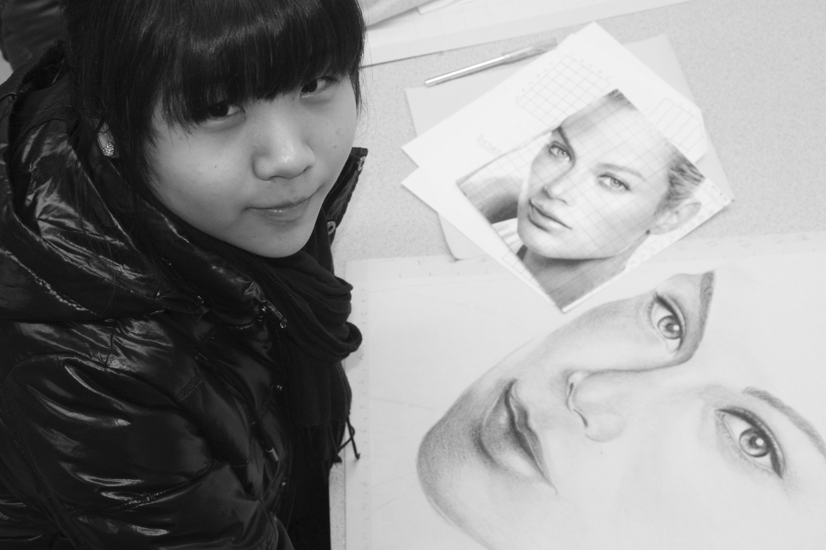
Art electives
Art 11 & 12
Animation 11 & 12
Art Careers 12
Ceramics & Sculpture 11 & 12
Graphics 11 & 12
Drawing & Painting 11 & 12
Fabric & Fibre 11
Photography 11 & 12

Slide 17
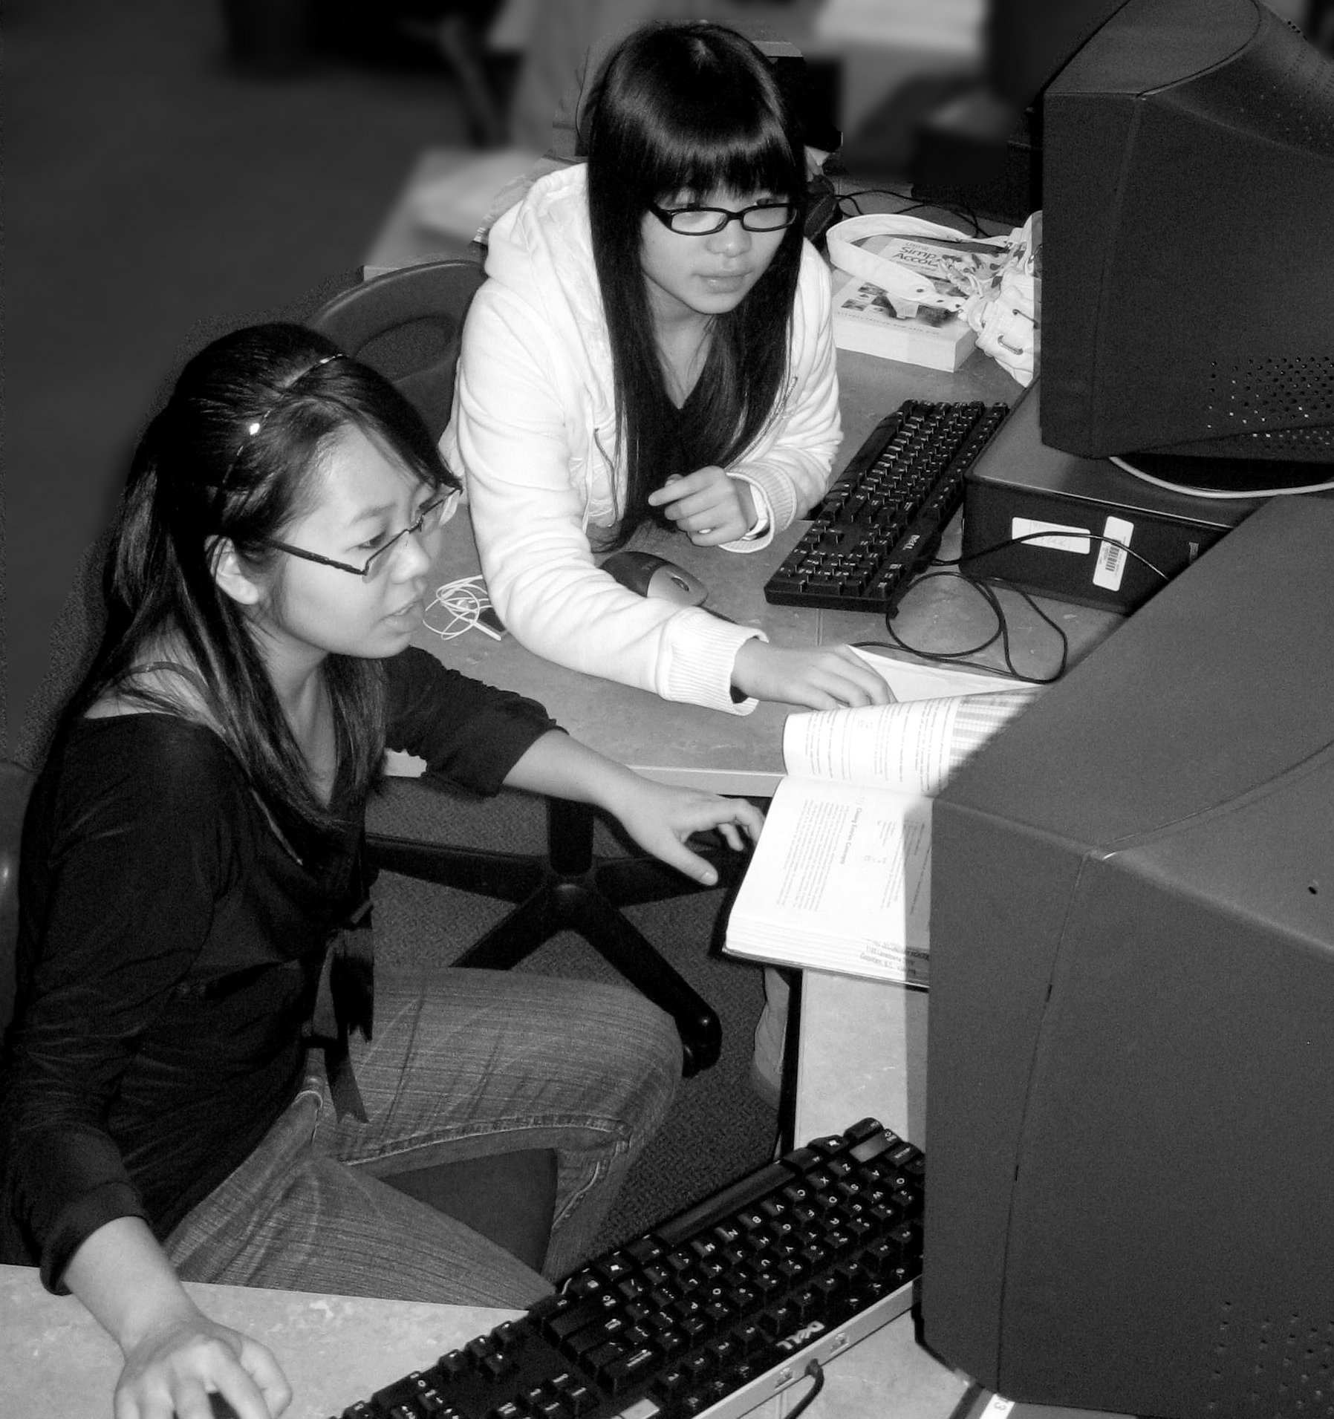
Business Education electives
Accounting 11 & 12
Computer Applications 11
Keyboarding 11
Marketing 11 & 12
Entrepreneurship 12

Slide 18
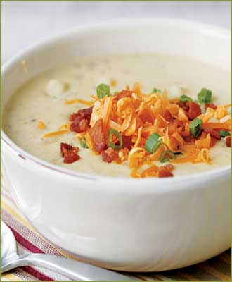
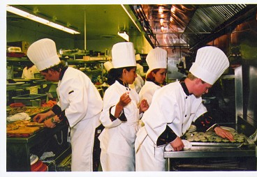
Culinary Arts electives
Cafeteria Training: 11 & 12

Slide 19
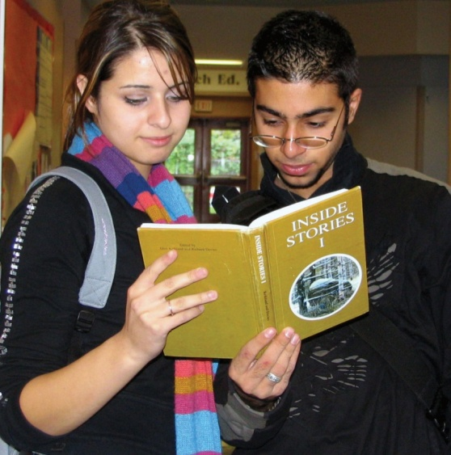
English electives
Journalism 11 & 12
Creative Writing 12
English Literature 12

Slide 20
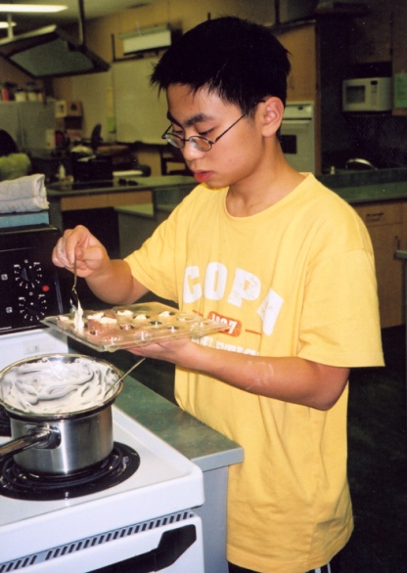
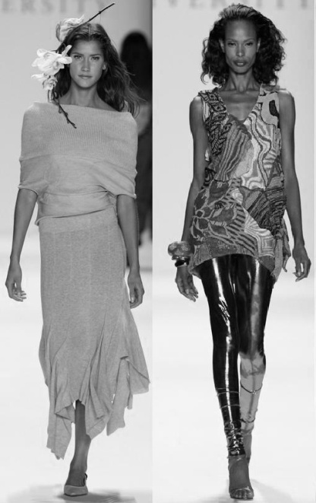
Home Economics electives
Child Development 11
Family Studies 12
Foods & Nutrition 11 & 12
Fashion Design 11
Textile Studies 11 & 12
Tourism 12

Slide 21
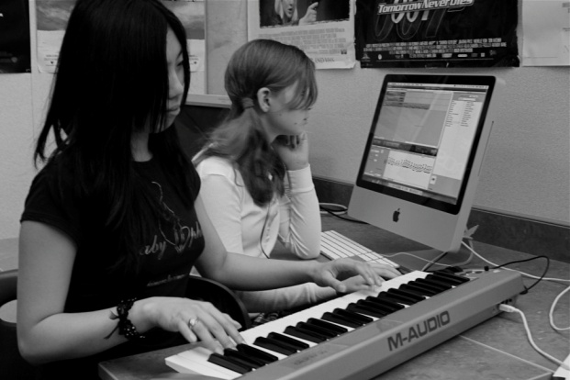
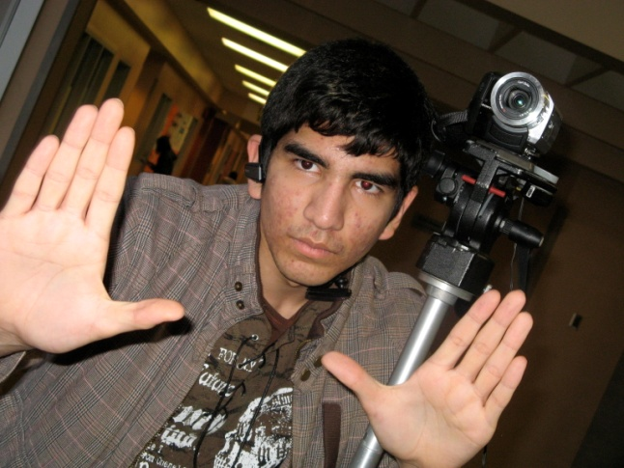
Information Technology electives
Animation 11 & 12
Computer Programming 11 & 12
Digital Film Making 11 & 12
3D Game Design 12
Digital Media Development 10, 11 & 12

Slide 22
Leadership electives
Leadership 10, 11 & 12
Athletic Leadership 12
Peer Tutoring 11 & 12
CON-X Leadership 11 & 12 (application required)

Slide 23
Music electives
Band 10: alternates with PE 10
Band 11 & 12 : alternates with Eng 11 & 12
Beginner Guitar 11
Choir 10, 11 & 12 : outside normal timetable
Jazz Band 10, 11 & 12 : outside normal timetable
Jazz Choir 10, 11 & 12 : outside normal timetable

Slide 24
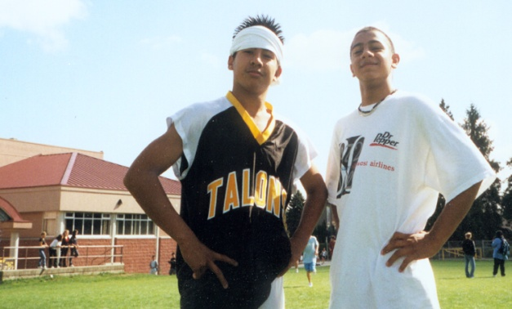
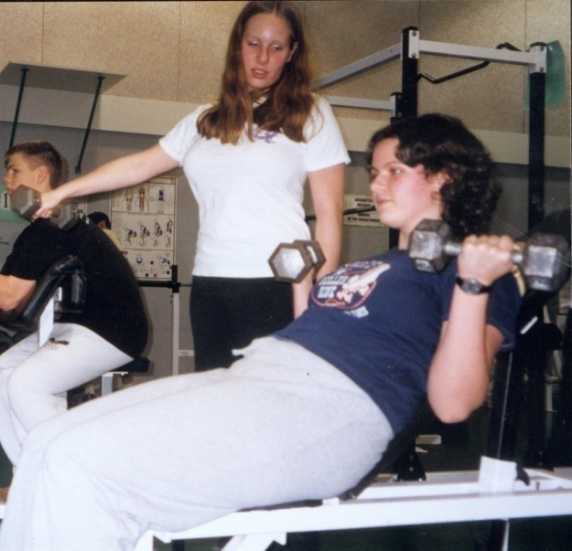
Physical Education electives
Fitness 11 & 12
Fitness 11: Aerobics
Physical Education 11 & 12
Sports Medicine 11

Slide 25
NEW 2015
Innovative Fitness
Athletic Academy
Certified Training Coaches Provide Guided Instruction
Individual Programs with Sport Science Guest Speakers
3 workouts sessions at Innovative Fitness (IF) in Port Moody each week. Also included: nutrition sessions, sports psychologist guest speakers etc… This course will run during our X Block in the morning
Students are responsible for their own transportation to and from the facility
For further info Contact: Chris Turpin cturpin@sd43.bc.ca Simon Quinto squinto@sd43.bc.ca

Slide 26
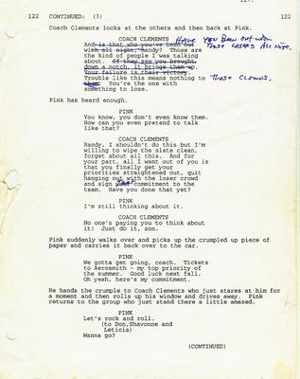
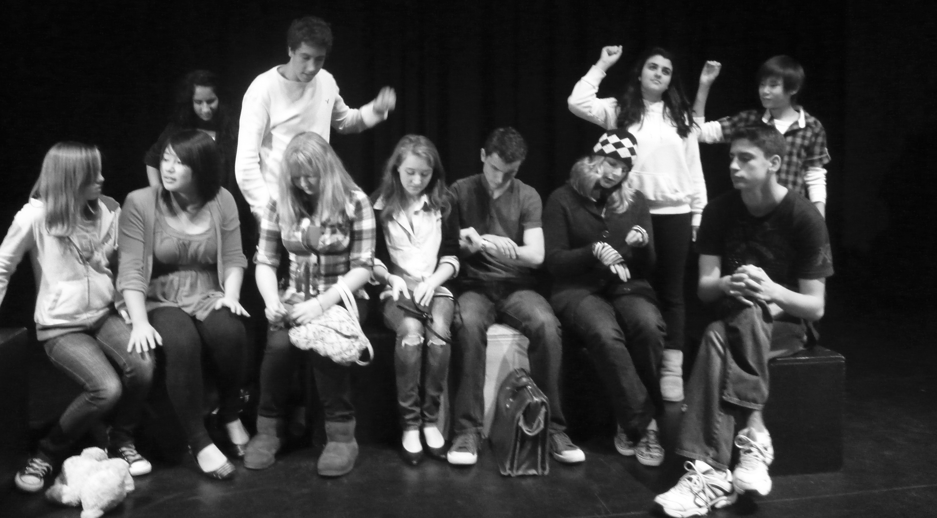
Theatre electives
Theatre Performance 11 & 12
Theatre Production 11
Theatre Script Writing 12
Musical Theatre 11
Musical Theatre 12

Slide 27
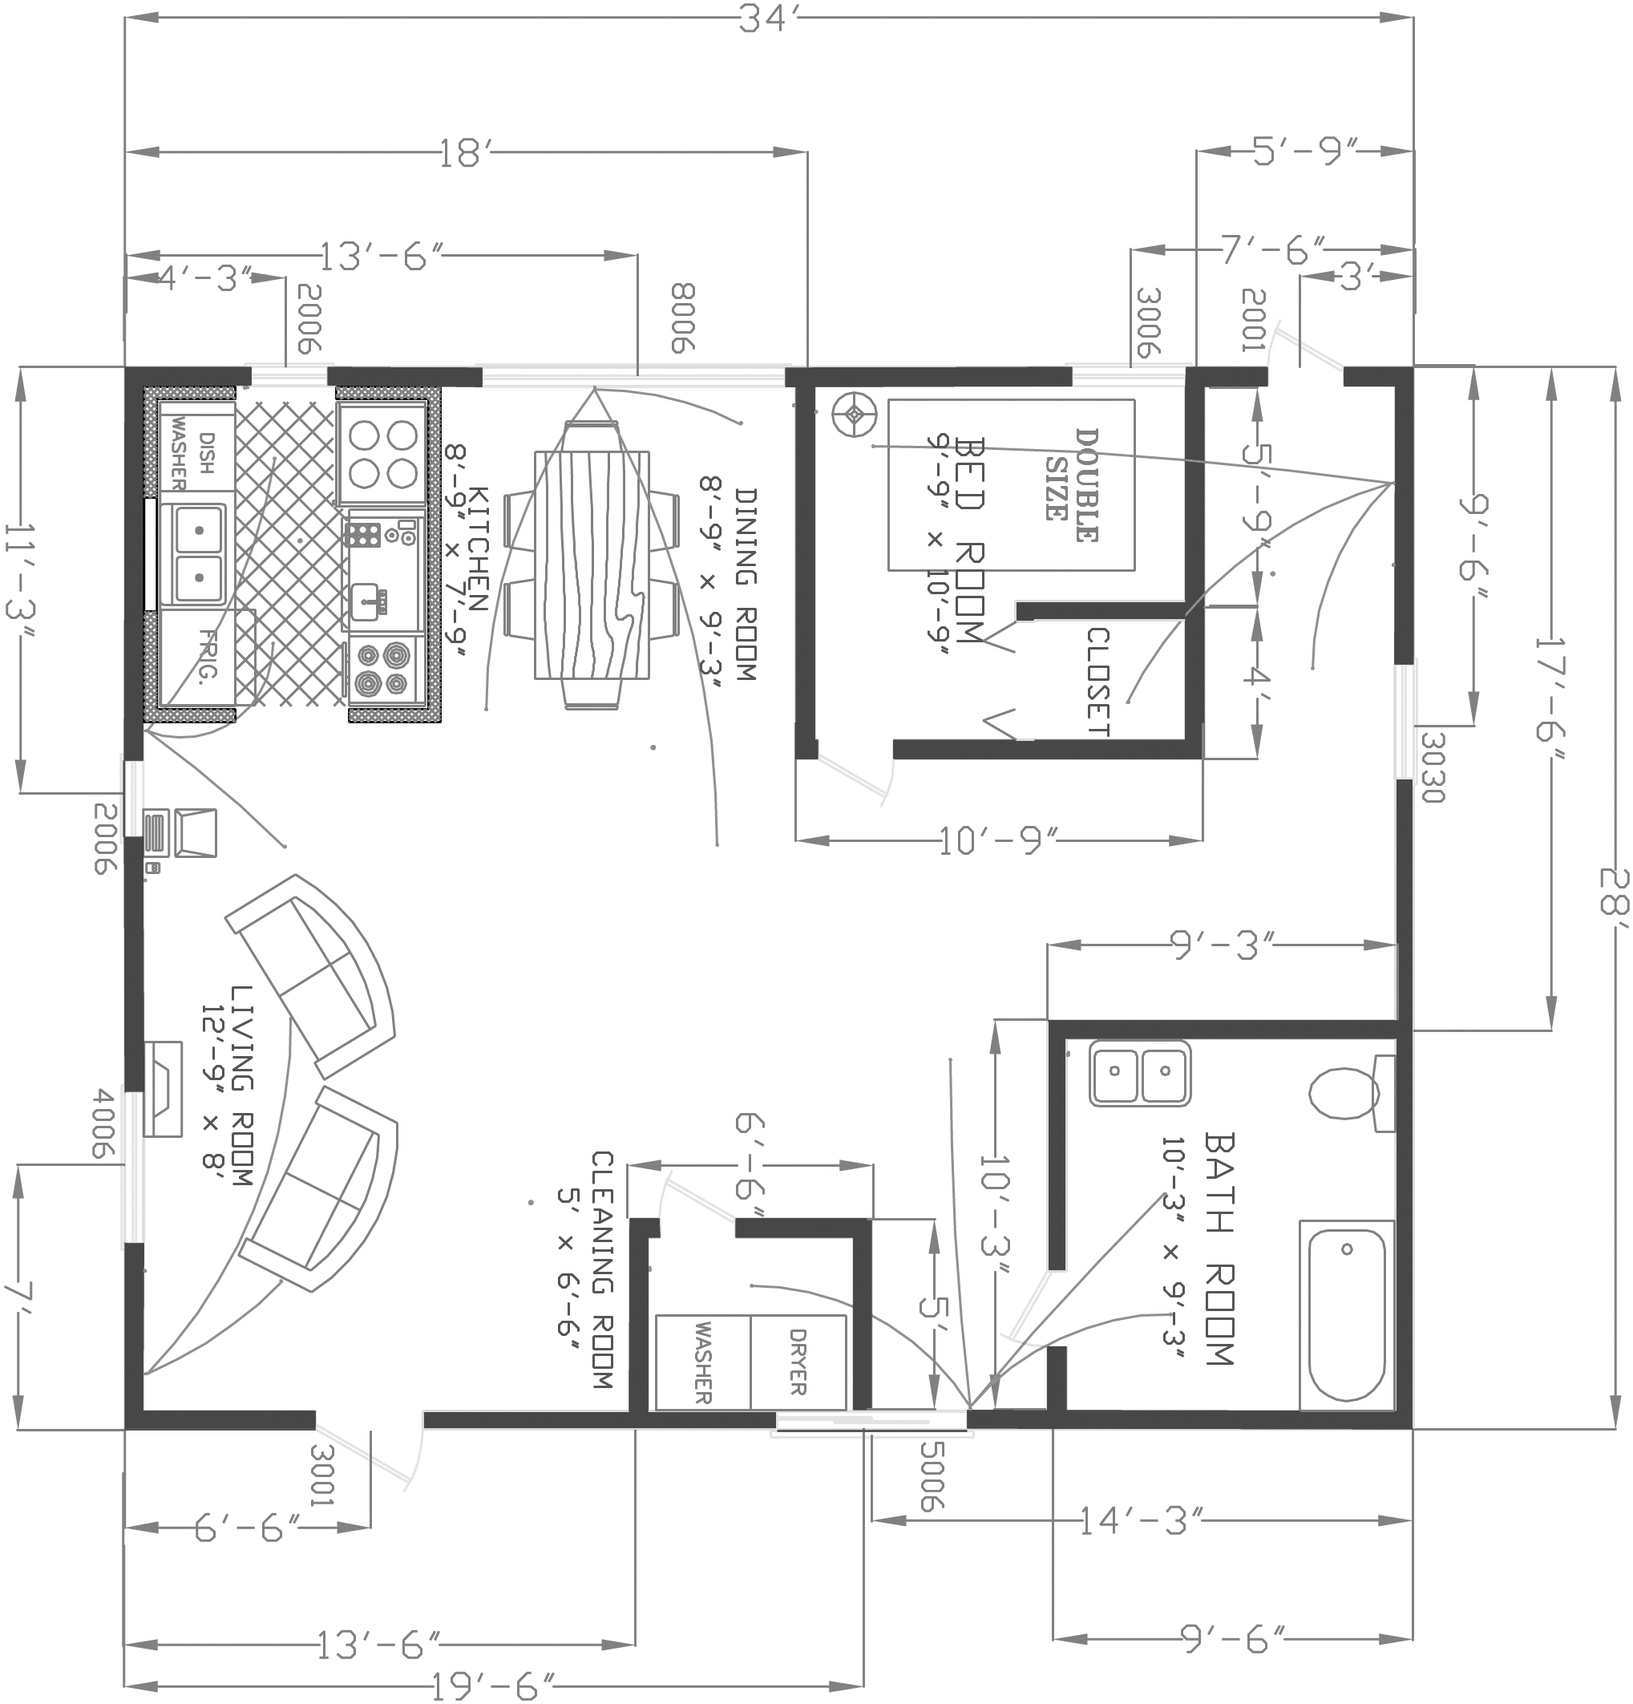
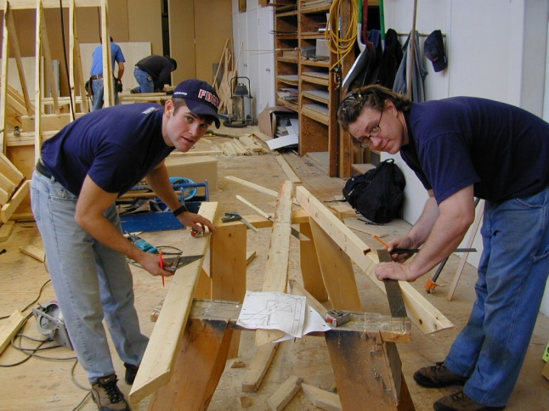
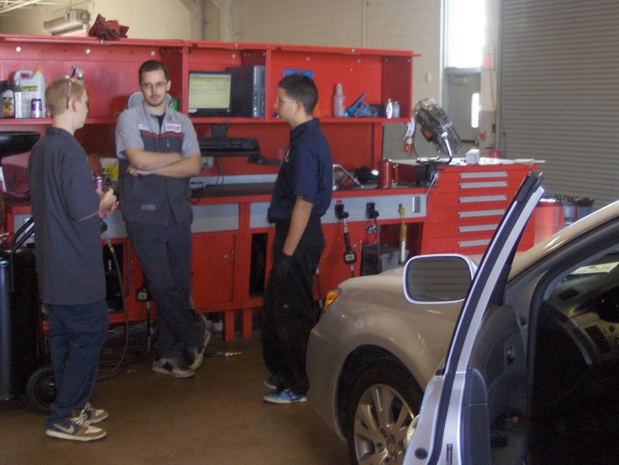
Technology Education electives
Automotive Tech 11 & 12
Auto Maintenance 11
Carpentry & Joinery 11 & 12
Drafting & Design 11 & 12
Advanced Design 12

Slide 28
District Program: COAST
For Grade 10 Students
Application required
Combines Outdoor Education with academic study
Semester 1 Semester 2
a Math 10 English 10
Science 10 Social Studies 10
an Elective P.E. 10 & 11
an Elective Leadership 10
Planning 10 ‘online’
(4 trips)

Slide 29
District Program: COAST
Backpacking & Hiking
Canoeing & Kayaking
Orienteering
Survival Skills
Winter Camping
Map & Compass Navigation
Rock Climbing
Cycling
Cross-country Skiing
Snow-shoeing
First Aid

Slide 30
Do I need a
Language?
Students do NOT need a second language to graduate, but…
SFU requires introductory language 11
UBC requires a language 11

Slide 31
ELL: English Language Learner
ELL Levels 1 & 2
ELL Level 3
Skills 10
Canadian Studies 10
Composition 11
* ELL teacher must check course selections

Slide 32
AP is the ANSWER for the academically talented student
Advanced
Placement
We offer the following AP Courses:
AP Calculus AB
AP European History (Prep)
AP Psychology (Prep)
AP Economics (Prep)
Other exams available upon request

Slide 33
Advanced
Placement
Can AP courses be used for admission to university?
YES!
Both SFU and UBC will accept AP courses in the calculation of the first year admission average.
Check post-secondary websites for details.

Slide 34
Graduation Transitions www.gleneagle.org
Assignments due Feb 13th
Exit Interviews April 23rd

Slide 35
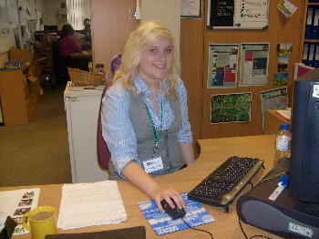
Work Experience
quick overview
Program designed primarily for Grade 12 students who wish to explore a chosen career field
120 hrs in the course (like all courses) 30 hrs in classroom + 90 hrs in community (after school, weekends, holidays, school days, Christmas & Spring break,… whatever we can work out)

Slide 36
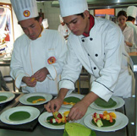
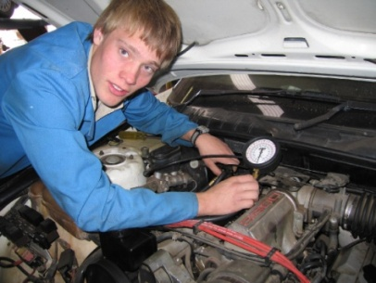
Work Experience
Examples of placements
Dental Assistant @ Rocky Point Dental Clinic
Mechanic @ Coquitlam Chrysler
Veterinarian @ Eagle Ridge Animal Hospital
Nurse @ Hawthorne Care Centre
School teacher @ Eagle Ridge Elementary
Daycare worker @ Panda Bear Daycare
Graphic artist @ Superior Signs
Cook @ Pasta Polo
Journalist @ Youthink Newspaper
and so many more opportunities!

Slide 37
Work Experience
why take it?
Specialize in an elective field
Real job experience in a chosen field
Networking
Work Experience 12a count as a normal grade 12 subject for graduation
Potential employment opportunities
Priority placement or reserved seating at some colleges
Can use it towards 30 hrs of Graduation Transitions

Slide 38
Apprenticeship
I have a paying job in a trade!
examples:
Appliance Technician
Bricklayer (Mason)
Chef / Cook
Floor Covering Installer
Glazier
Hairstylist
Hardwood Floorlayer
Landscaper
Locksmith
Meatcutter
Painter and Decorator
Partsperson
Refrigeration Mechanic
Security Alarm Installer
Sprinkler Sys. Installer
Tilesetter
Vehicle Body Repairer
Welder
Designed for high school students who want a paid job in one of the 100+ apprenticeable trades (see ITABC.ca)
Earn up to 16 credits (4 courses) towards graduation for employment… 120 hrs of work = 4 high school credits
Work hours count towards the completion of Level 1 certification
Can qualify for a $1,000 scholarship

Slide 39
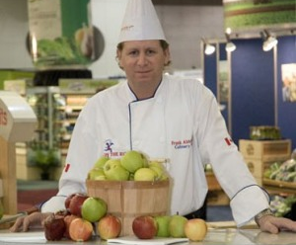
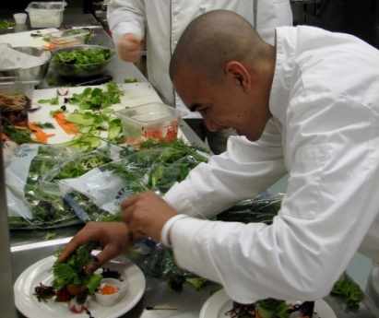
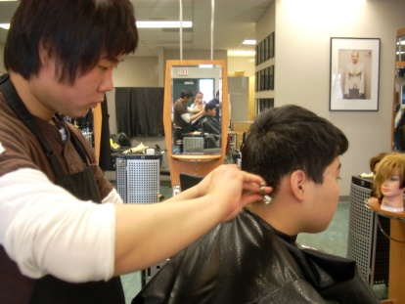
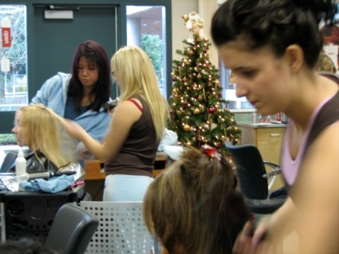
Apprenticeship
can I get trained in a trade?
Gleneagle (District) ACE-IT Programs
Culinary Arts - Chef Frank Abbinante 4 Culinary Arts courses (in Spring semester) Write “Professional Cook – Level 1” exam Can also get credit for Work Exp and SSA
Hairdressing – Janet Kim 7 Hairdressing courses & Eng 12 (or Comm 12) Write ITA exam (and optional BC exam, $125) Can also get credit for Work Exp and SSA

Slide 40
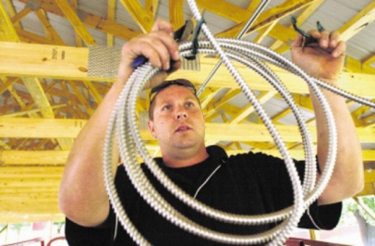
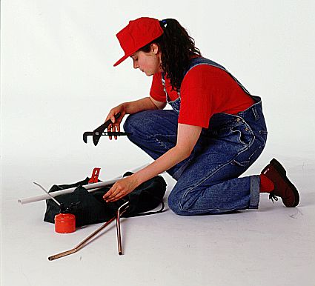
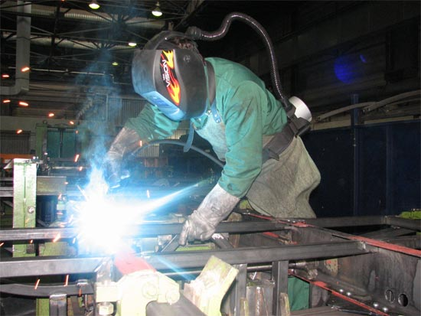
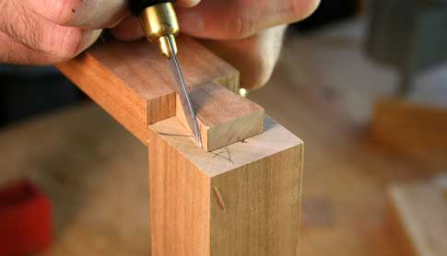
Apprenticeship
can I get trained in a trade?
Other Coquitlam School District ACE-IT Programs
Electrician (construction) Charles Best
Mechanic (car/truck) Centennial
Joinery / Cabinet Making Charles Best
Carpentry Terry Fox and Kwantlen (working together)
Painting Finishing Trades Institution (Surrey)
Baking/Pastry VCC
Plumbing Training facility on Annacis Island (New Westminster) 1st year tuition is paid for must be June Grad
Metal Fabrication BCIT
Millwright BCIT

Slide 41
Opportunities for Enrichment
Advanced
Placement
Advanced Placement (AP) Courses
developed at Princeton University
university level courses for high school students
attain first year university credit while still in high school

Slide 42
Many great Learning
Opportunities
Where will I be after I graduate from high school?
college
university
trade programme
apprenticeship
certificate or diploma program

Slide 43
Douglas College:
Basic Entrance Requirements
Entrance Requirements
English 12: “C”, or Communications 12: “B”
Grade 12 course prerequisites to some courses (Math, Sciences, English12 “B” for 1st yr English)
Specific requirements for some programs – check website

Slide 44
Douglas College:
Reserved Seating
Coquitlam School district and Douglas College have an agreement to reserve seats for our students in the following areas:
Bachelor of Science in Nursing
Psychiatric Nursing
Dental Assisting
Dispensing Optician
Health Care Support Worker
Health Information Management
Animal Health Technology

Slide 45
Douglas College:
Concurrent Studies
Take Douglas College courses while you are still in grade 12 at Gleneagle (Dual Credit)
Good for students who want:
to gain post-secondary credits now
courses not available at high school
Criminology
Stagecraft
Astronomy
Hotel and Restaurant Management
Exploring Perspectives (ECE-based)
Others…

Slide 46
Douglas College:
SFU – Douglas College Partnership
Earn a Bachelor of Arts degree from Simon Fraser University, while studying at both Douglas and SFU.
Partnership allows you to move freely and easily between both institutions to complete the degree requirements
Not the same as transferring from Douglas to SFU.
Transferring usually involves leaving a college to attend university and submitting a request to the university to give you credit for college courses. Once you transfer to university you cannot go back to the college to complete additional credits without permission. The Douglas College-SFU partnership program is much more flexible.

Slide 47
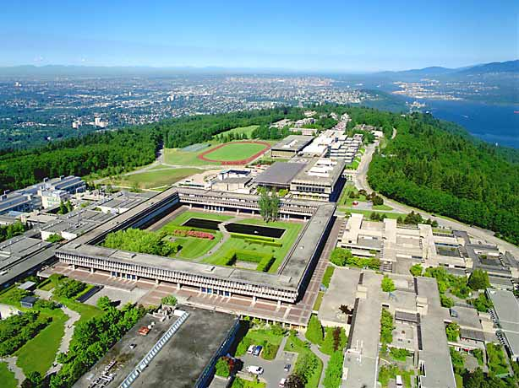
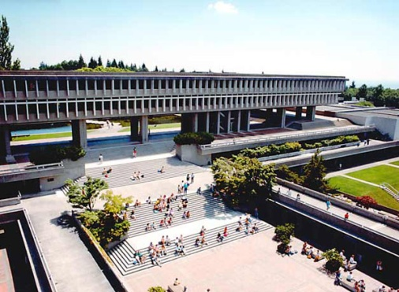
SFU:
Minimum admission requirements
Principles of Math 11, or Found. of Math & Pre-Calc 11: 70%
(60-69% you will need to satisfy additional Math requirements)
English 12: 60% min.
(60-74% must satisfy additional literacy requirement within first 3 terms)
Admission based on 4 “academically approved” courses… (Eng 12 + 3 more)… see admissions website for more information
see www.sfu.ca

Slide 48
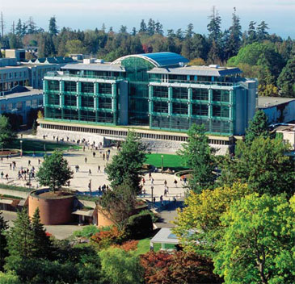
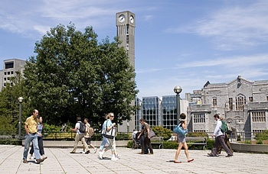
UBC:
Minimum admission requirements
Based on 4 “academically approved” courses…see admissions website for more information
Must have completed mark of 70% in English 11 or 12 before being admitted
See www.ubc.ca

Slide 49
Post Secondary
Opportunities
For current and up to date information, check out the post-secondary websites.
Visit Ms. Devlin in the Career Centre room 213 for information, calendars, applications and scholarships.

Slide 50
Show me the Money!
Scholarships, Bursaries & Financial Aid
Talk to MS. Devlin (Career Resource Facilitator) in room 213
Check out her SharePoint site on gleneagle.org
Talk to your parents… employers may offer scholarship program
Search www.studentawards.com
Search university websites

Slide 51
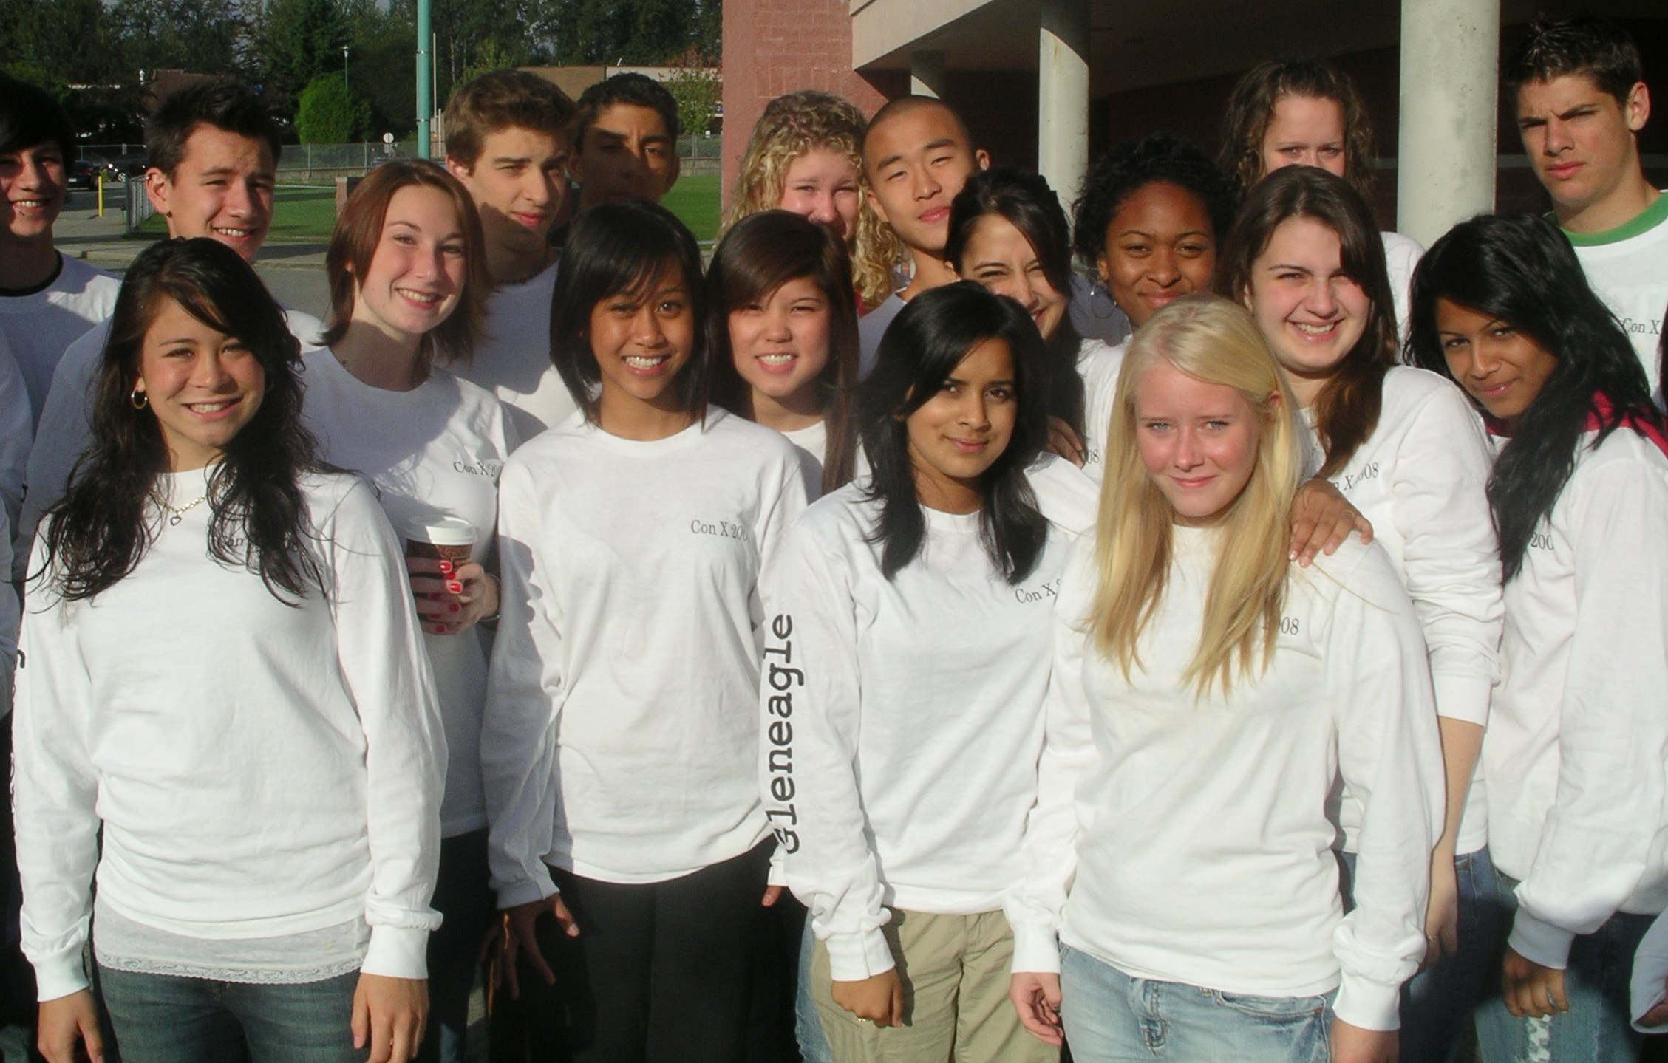
Well-rounded Students
The Well-Rounded Students
Academics
Athletics
Global Issues Club
Yearbook
Snowboard Club
Outdoors Club
Volunteering
Student Council
Grad Committee
Jazz Band
Tutoring
Intramurals

Slide 52
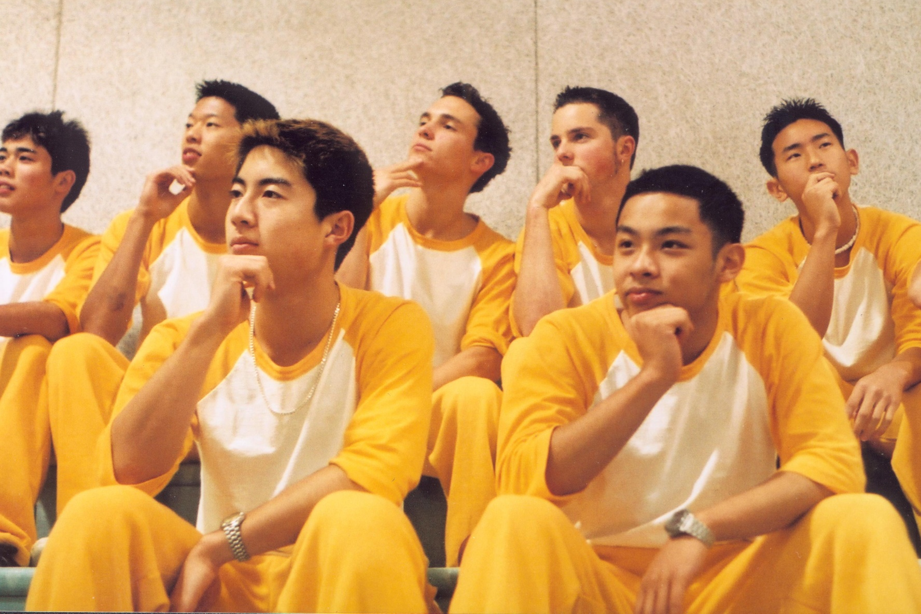
Extra-curricular
Activities
Get involved!

Slide 53
Gleneagle.org
Tons of Stuff !

Slide 54
Due Date: Course Selection Sheets
Course Selection Forms need to be completed by:
Friday, Janurary 29
Return to your Block 1 Teachers

Slide 55
plan your courses carefully!
Your Gleneagle years are exciting and crucial years…
“Destiny is not a matter of chance it is a matter of choice.” anonymous

Slide 56
Counsellors: Questions & Information
Access our Course Selection Booklet: gleneagle.org
Mr. Areshenko jareshenko@sd43.bc.ca A - H
Mrs. Johal bjohal@sd43.bc.ca I - O
Mrs. Martin smartin@sd43.bc.ca P - Z
Ms. Horvath jhorvath@sd43.bc.ca
Work Exp, DPA, ACE-IT & GT

Slide 57
Thank you

